Slide 1
Random Forest Regression
Machine Learning with Python

Slide 2
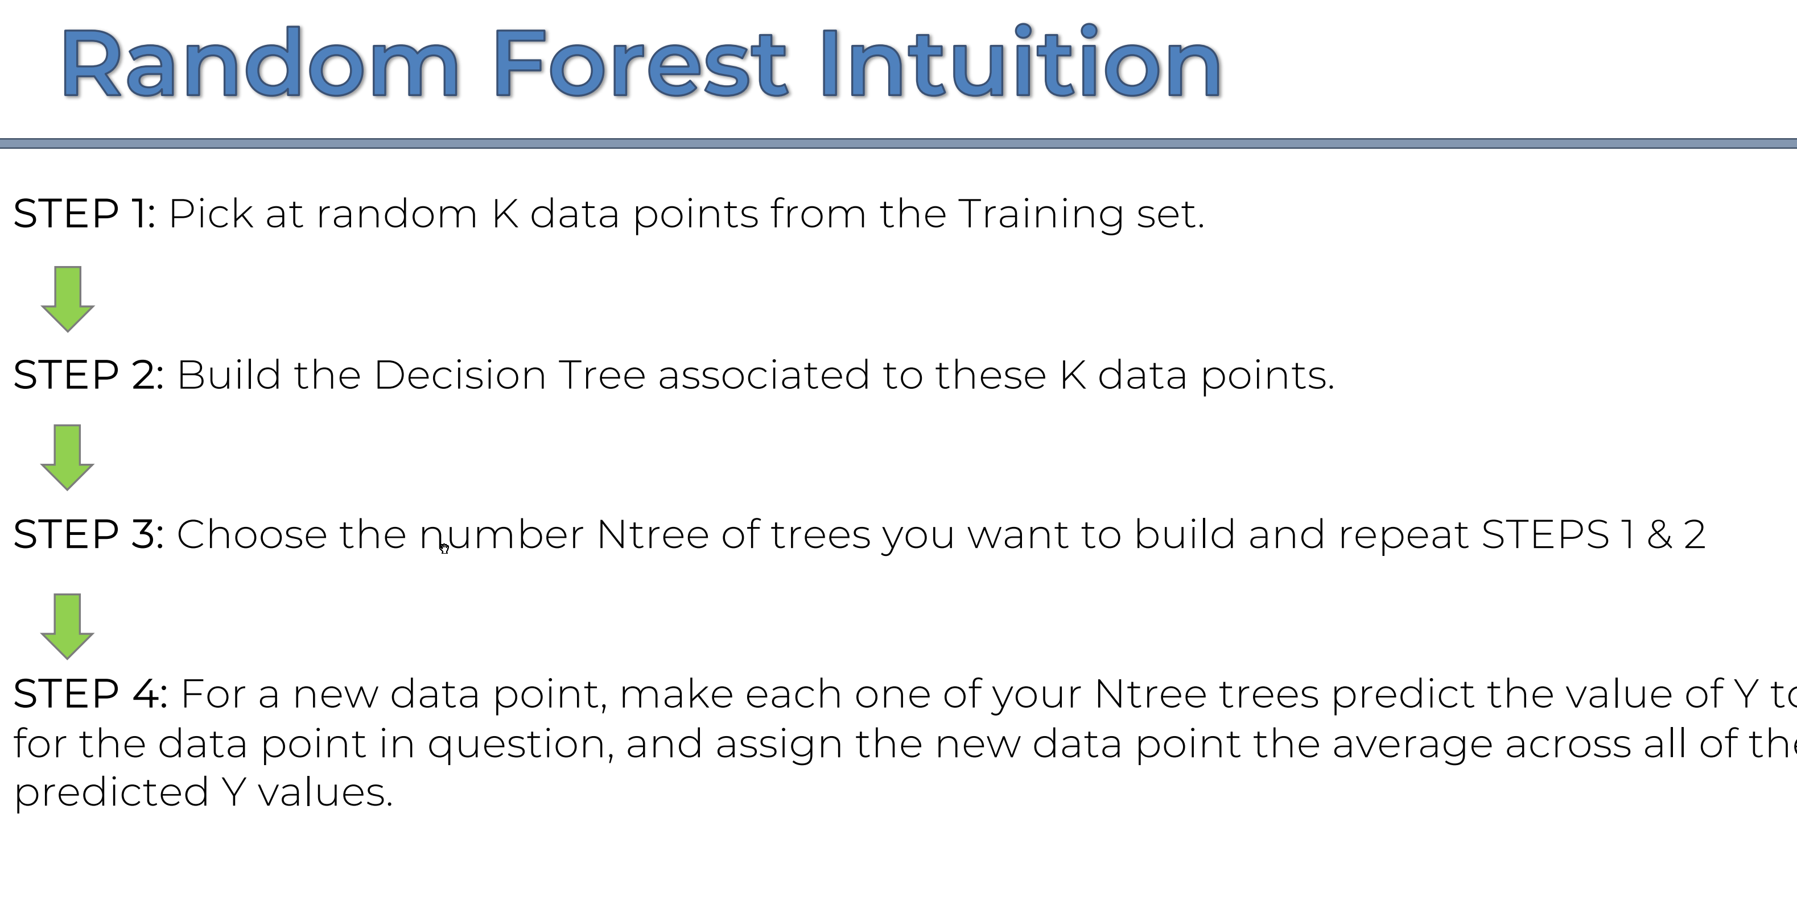

Slide 4
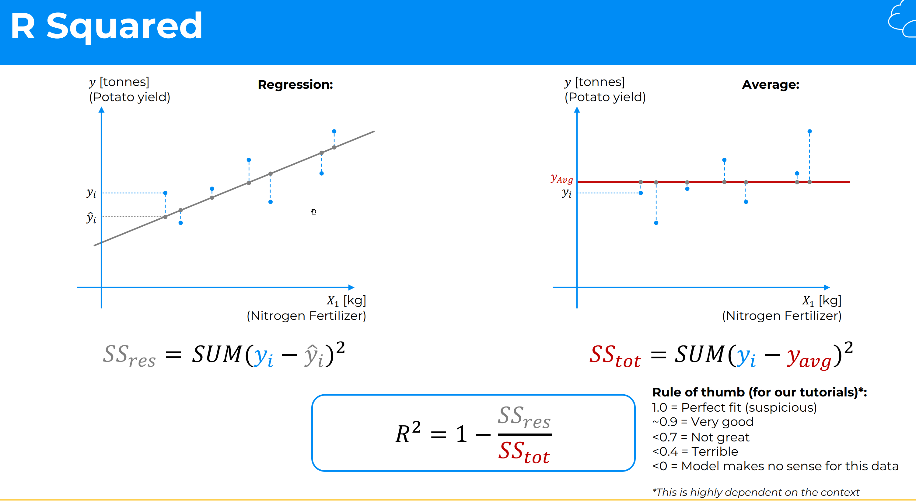

Slide 5
